Slide 1

Technopreneurial Marketing
Exploring the Role of
Improving
Customer
Service
Group - 26
Group Project
Abhinay Pandey (21BT3EP11)
Harshikant Dubey (21AG3EP30)

Slide 2

Exploring the Role of Chatbots in Improving Customer Service
Introduction:
AI-powered chatbots are transforming customer service by automating interactions across industries. While they excel at quick responses, their ability to handle complex issues remains debated. This study explores their impact on customer satisfaction, loyalty, and engagement.

Slide 3

The objective of this study is to analyze how chatbots improve customer service by enhancing user experience, satisfaction, and operational efficiency.
Problem Statement:
Scope and Significance:
This study explores the impact of chatbots on customer service in India, analyzing adoption trends and improvement strategies. It helps businesses optimize AI-driven support systems.

Slide 4
Data Collection Method:
Online structured questionnaire for accessibility.
Measured user experience across key constructs:
Ease of Use 🖱️
Response Speed ⏩
Accuracy ✅
Personalization 🤖
Customer Satisfaction 😊
Problem-Solving Effectiveness 💡
Consistency & Trustworthiness 🔒
Integration with Human Support 👥
Methodology – Research Design

Slide 5
Literature Review
Literature Review – Introduction
Chatbots are transforming customer service by improving speed, availability, and efficiency.
Existing Research Focus:
Response speed
Personalization
Customer satisfaction
Trust and security
Integration with human agents
Purpose of the Literature Review:
Summarizes key findings from previous studies.
Identifies areas for improvement and gaps in research.

Slide 6
Customer Satisfaction & Trustworthiness
Response Speed & Efficiency
|
Personalization & Context Awareness
Why personalization matters:
Customers prefer tailored experiences over generic responses.
How chatbots achieve personalization:
Use Natural Language Processing (NLP) to analyze customer queries.
Remember past conversations and preferences.
Offer product recommendations & customized solutions.
Impact:
Increases customer engagement & loyalty.
Makes interactions feel more human-like.
Chatbots provide instant responses, reducing wait times and improving customer satisfaction. They handle queries 70% faster than human agents and operate 24/7, ensuring no query goes unanswered. This efficiency builds trust and allows human agents to focus on complex issues.
​

Slide 7
Constructs:& ss
Integration with Human Support
Customer Satisfaction Factors:
24/7 availability → No waiting time.
Quick issue resolution → Customers get instant solutions.
Friendly & engaging chat style → Improves user experience.
Trust Factors:
Customers trust chatbots that are transparent about being AI.
Secure data handling is essential for user confidence.
Why human support is still needed:
Chatbots handle routine queries well but struggle with complex emotional issues.
Customers expect seamless transitions to human agents.
Best Practices for Integration:
Chatbots should provide conversation history when escalating to humans.
Hybrid support model: AI + Human = Best customer experience.
Example:
Banking chatbots hand over loan disputes to human agents.

Slide 8
Questionnaire Development
1. Basic Information Questions (Demographic Data)
2. Behavioral Questions
Age group
Gender
occupation
Geographic location
Experience with chatbots
Frequency of chatbot usage
Preferred customer service channel
Rating of chatbot experience compared to human agents
Common purposes for using chatbots
3. Contextual Questions
Purpose of the last chatbot interaction
Industry of the most recent chatbot interaction
Smoothness of transition between chatbot and human agent
Ease of Use (EU)
Effectiveness in resolving issues
Response Speed (RS)
Accuracy and Relevance of Information (ARI)
Personalization and Context Awareness (PCA)
Problem-Solving Effectiveness (PSE)
Consistency of Responses (CR)
4. Construct-Specific Questions
Trustworthiness and Security (TS)
Integration with Human Support (IHS)
Customer Satisfaction with Interaction (CSI)

Slide 9
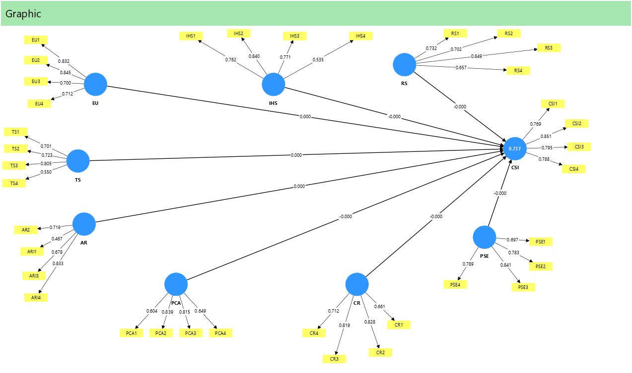
SmartPLS & Pilot Testing:
After getting the respnses from the survey we converted the categorical data in to numeric and manages the missing values
.

Slide 10
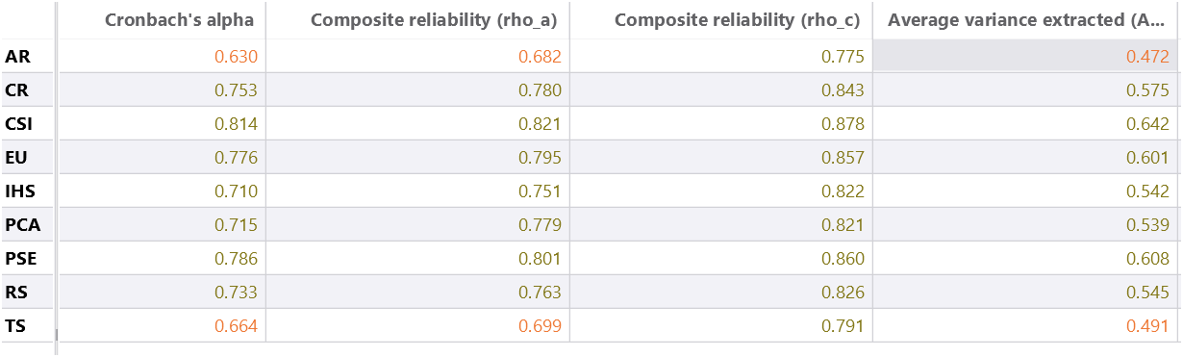
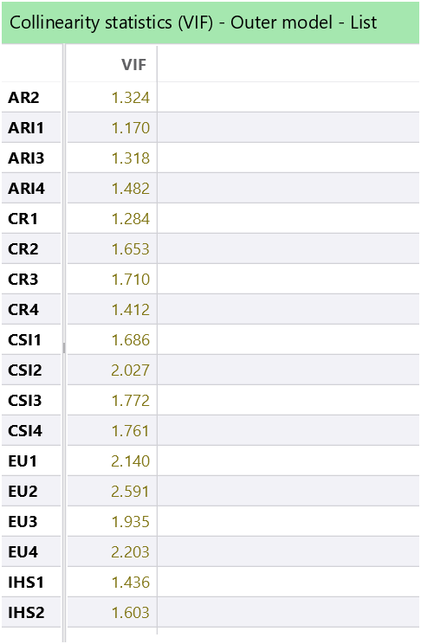
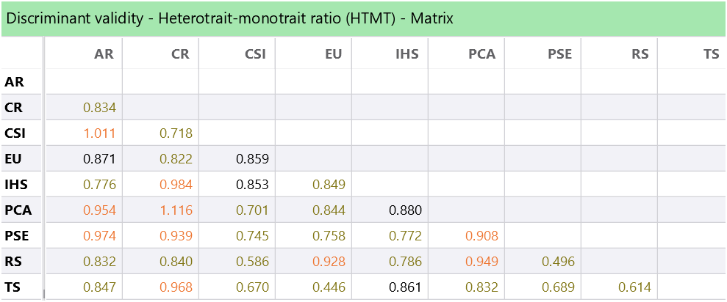
Pilot Testing Data Analysis

Slide 11
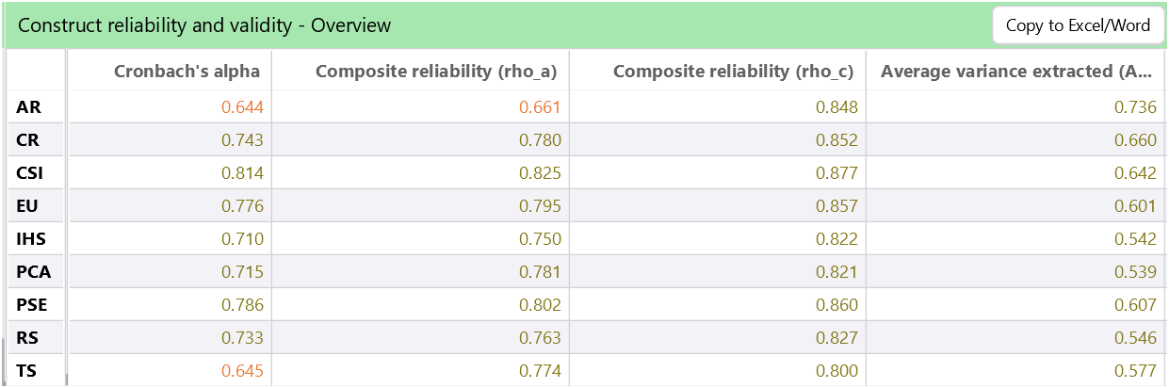
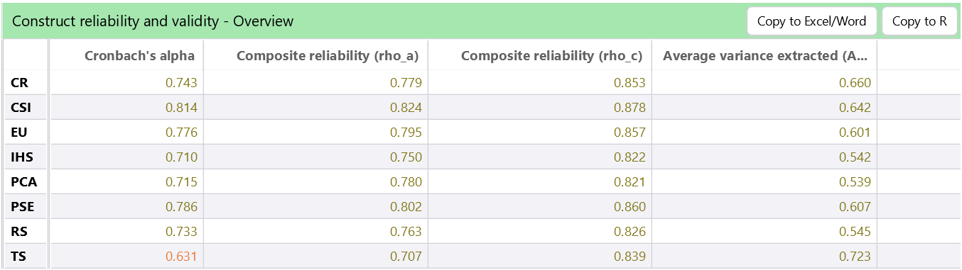
Cronbach’s Alpha
Cronbach’s Alpha measures the internal consistency or reliability of a construct's indicators (questions). A value of ≥0.7 indicates acceptable reliability.
Formula:
α = (k / (k - 1)) * (1 - (Σσ²ᵢ / σ²ₓ))
Where:
α = Cronbach's alpha coefficient
k = The number of items (or questions) in the scale
Σσ²ᵢ = The sum of the variances of each item (σ²ᵢ)
σ²ₓ = The variance of the total score (the sum of all item scores)
Significance: Cronbach’s Alpha ensures that all items within a construct measure the same underlying concept.
After removing questions from AR1,2,3 and CR1 we got a better Cronbach's alpha value Which again improved after removing TS2,TS4

Slide 12
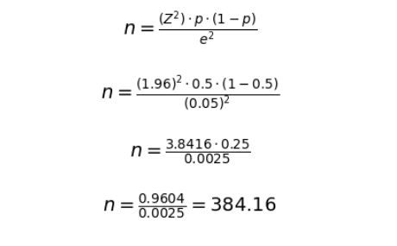
Sample Size Calculation
We have collected around 390 samples.
The free version of SmartPLS can only deal with up to 100 respondents.
That's why python is used here for the rest of the primary data analysis.
Bar Graphs of each questions are plotted.
ANOVA analysis has been done for the primary data
Descriptive Statistics has been derived using python.
Reliability Analysis (Cronbach's alpha) analysis has been done.
Z=1.96: Z-score for a 95% confidence level.
p=0.5
p=0.5: Assumed proportion of the population.
e=0.05: Margin of error (5%)
Assuming Infinite population, we need to take 385 samples minimum

Slide 13
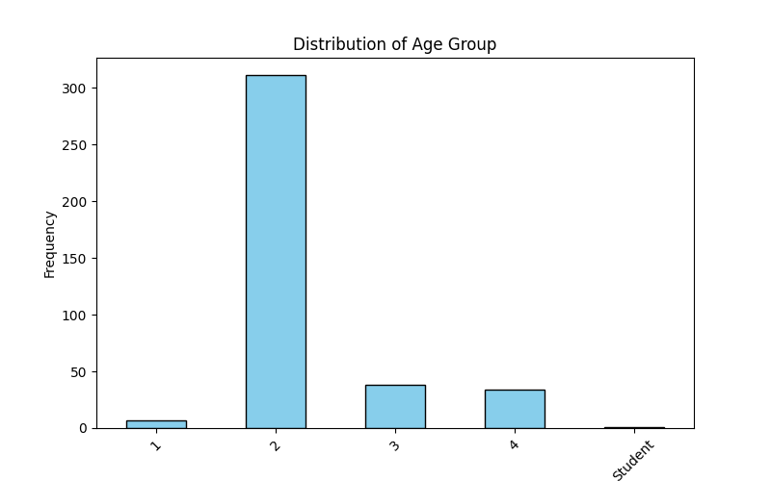
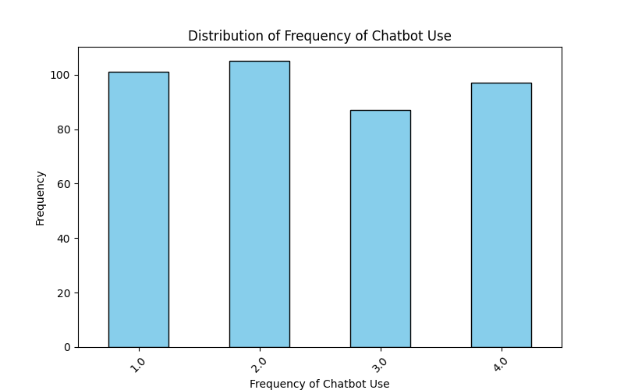
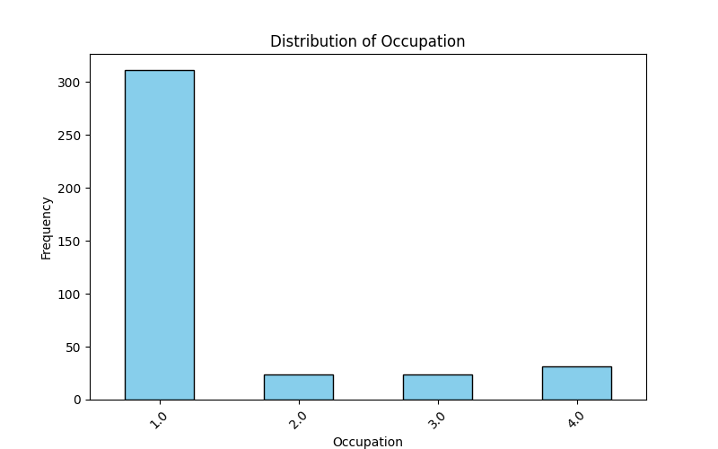
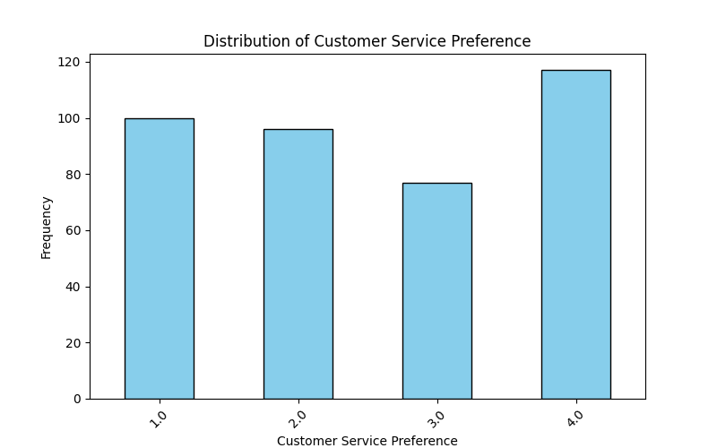
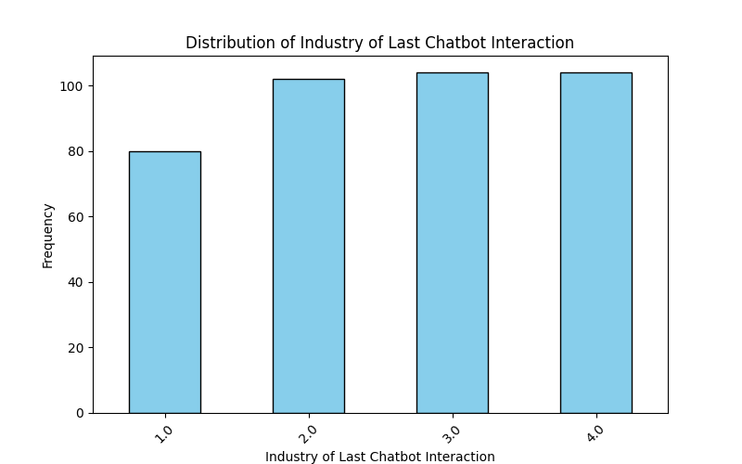
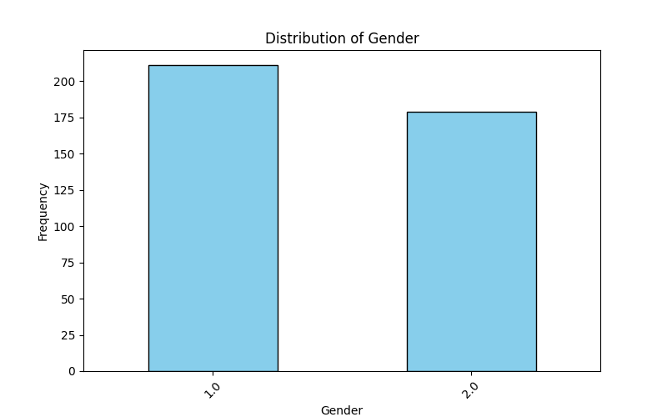
Data Analysis of Chatbot Survey(Bar Graphs)

Slide 14
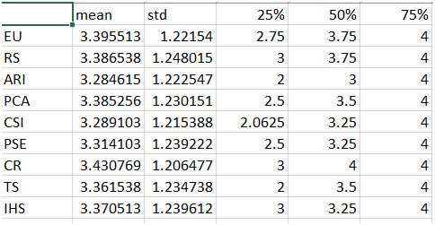
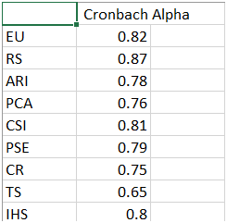
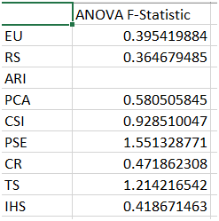
Discriptive Statistics Analysis ,ANOVA ,Reliability Analysis(Cronbach's Alpha Test)

Slide 15
Results & Validation:
Cronbach’s Alpha:
Constructs like Ease of Use (0.82), Response Speed (0.87), and CSI (0.81) showed strong reliability (>0.8).
Trustworthiness and Accuracy had lower reliability, requiring refinement.
Descriptive Statistics:
Mean scores ranged from 3.3–3.4, indicating moderate agreement with survey items.
Highest mean: CR (3.43), showing chatbot responses are perceived as consistent.
Lowest mean: ARI (3.28), suggesting slightly lower satisfaction with accuracy.
ANOVA Results:
CSI (F = 0.9285) and PSE (F = 1.5513) showed significant variance, highlighting their importance in customer satisfaction.
EU (F = 0.3954) and RS (F = 0.3646) exhibited less variance, indicating stable perceptions.

Slide 16
Validation of Objectives
Ease of Use: Strong reliability and positive impact on CSI, confirming user-friendly interfaces enhance satisfaction.
Personalization: Significant influence on CSI, validating tailored interactions as key to improving experiences.
Integration with Human Support: Positive impact on CSI, emphasizing seamless transitions for complex queries.
Trustworthiness: Lower reliability and limited impact, suggesting functionality is prioritized over security.

Slide 17
Comparison with Research Papers
Results align with studies emphasizing usability and personalization as major drivers of satisfaction.
Weak impacts of trustworthiness and accuracy reflect findings that customers prioritize efficiency over security in chatbot interactions.
Integration with human agents supports literature highlighting hybrid support systems for complex queries.

